Slide 1

English Learning
Name: Morkhiya Devpriya Dineshbhai
Enrollment No: 23002170410014
Batch: C-1 Roll No : 08
Branch: AIML

Slide 2

Introduction
A platform, designed to empower learners.
Our application offers personalized resources and interactive exercises designed to enhance your language skills.

Slide 3

Website overview
Reading
Listening
Communication
Quiz

Slide 4
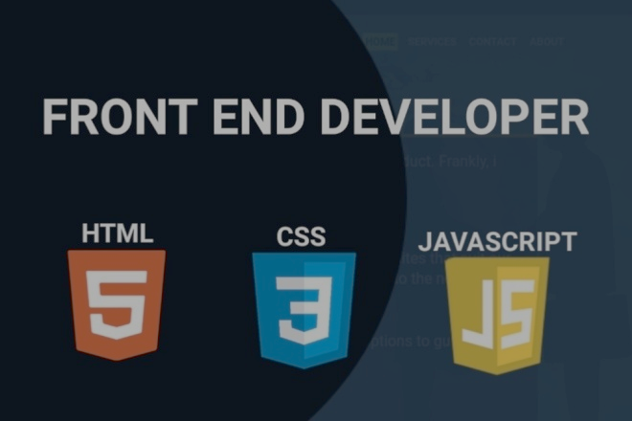
TECHNOLOGY STACK
HTML
JavaScript
Tailwind CSS

Slide 5

Conclusion
An English learning website created by using HTML, JavaScript and Tailwind CSS that meets the growing demand for accessible language education by providing essential resources that empower individuals to improve their English proficiency for personal and professional growth.

Slide 6

Key Takeaways
Classroom studies to practical implication
Plan-Implement-Test
Trial & Error - - - >Resolve & Evolve
End to end learning of Website designing

Slide 7
Thank you

Slide 8

About us
Looking for a Path to Fluency and Confidence in your communication? You’re on the right track!!!
If you imagine yourself as someone who is confidently speaking English, we are here to help you out!

